Slide 1
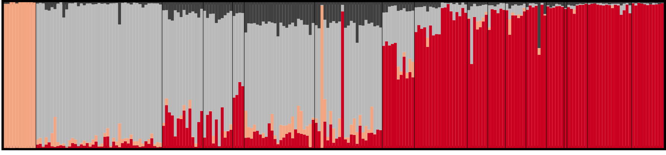
Lab 10: Population structure and assignment tests
BIOL4174/5174 Conservation Genetics Spring 2018

Slide 2
Population structure
Populations generally don’t consist of a single randomly-mating unit
Assortative mating due to:
Dispersal limitation
Geographic barriers
Differential adaptation
etc
Byrne et al (2018) PLoS Genetics

Slide 3
Inferring population structure
Most common approaches:
Approaches we’ve seen (genetic distances, F-statistics, AMOVA, etc)
Phylogenetic approaches (may not be informative at sub-specific scale)
Principle Components Analysis (PCA) / Dimension reduction approaches
Assignment Tests

Slide 4
Inferring structure: Assignment Tests
Used to assign ancestry to individuals, given allele frequencies for populations
Can be used to infer admixture, gene flow between populations
Commonly used methods:
Bayesian: Structure, BAPS, Structurama, fastStructure
Bayesian with geographical constraints: TESS, GENELAND
Likelihood: Admixture

Slide 5
Inferring structure: Assignment Tests
Used to assign ancestry to individuals, given allele frequencies for populations
Can be used to infer admixture, gene flow between populations
Commonly used methods:
Bayesian: Structure, BAPS, Structurama, fastStructure
Bayesian with geographical constraints: TESS, GENELAND
Likelihood: Admixture

Slide 6
Given two populations with allele frequencies:
 | SNP 1 | SNP 2 | SNP 3 | SNP 4
 | A/T | G/C | T/C | T/G | …
Pop1 | 0.6/0.4 | 0.9/0.1 | 0.7/0.3 | 0.4/0.6 | …
Pop2 | 0.5/0.5 | 0.3/0.7 | 0.8/0.2 | 0.1/0.9 | …

Slide 7
And an individual (X) of unknown origin:
 | SNP 1 | SNP 2 | SNP 3 | SNP 4
Ind X | A/T | G/G | T/T | T/G | …

Slide 8
And an individual (X) of unknown origin:
 | SNP 1 | SNP 2 | SNP 3 | SNP 4
Ind X | A/T | G/G | T/T | T/G | …
What is the probability Individual X came from Population 1?

Slide 9
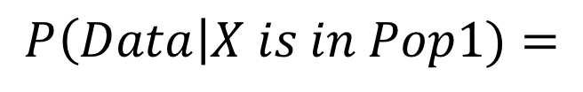
 | SNP 1 | SNP 2 | SNP 3 | SNP 4
 | A/T | G/C | T/C | T/G | …
Pop1 | 0.6/0.4 | 0.9/0.1 | 0.7/0.3 | 0.4/0.6 | …
Pop2 | 0.5/0.5 | 0.3/0.7 | 0.8/0.2 | 0.1/0.9 | …
Ind X
Ind X | A/T | G/G | T/T | T/G | …
$$P\left(Data\right|X is in Pop1)=$$

Slide 10
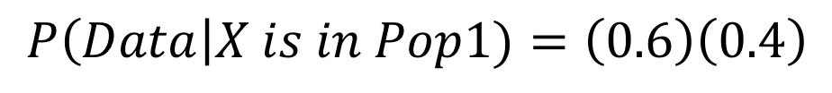
 | SNP 1 | SNP 2 | SNP 3 | SNP 4
 | A/T | G/C | T/C | T/G | …
Pop1 | 0.6/0.4 | 0.9/0.1 | 0.7/0.3 | 0.4/0.6 | …
Pop2 | 0.5/0.5 | 0.3/0.7 | 0.8/0.2 | 0.1/0.9 | …
Ind X
Ind X | A/T | G/G | T/T | T/G | …
A
T
$$P\left(Data\right|X is in Pop1)=\left(0.6\right)\left(0.4\right)$$
The probability of genotype A/T being sampled from Population 1, is the product of the probabilities of sampling an A, and sampling a T

Slide 11
 | SNP 1 | SNP 2 | SNP 3 | SNP 4
 | A/T | G/C | T/C | T/G | …
Pop1 | 0.6/0.4 | 0.9/0.1 | 0.7/0.3 | 0.4/0.6 | …
Pop2 | 0.5/0.5 | 0.3/0.7 | 0.8/0.2 | 0.1/0.9 | …
Ind X
Ind X | A/T | G/G | T/T | T/G | …
A
T
$$P\left(Data\right|X is in Pop1)=\left(0.6\right)\left(0.4\right)$$
$$P\left(SNP1=A/T\right|X is in Pop1)=0.24$$

Slide 12
 | SNP 1 | SNP 2 | SNP 3 | SNP 4
 | A/T | G/C | T/C | T/G | …
Pop1 | 0.6/0.4 | 0.9/0.1 | 0.7/0.3 | 0.4/0.6 | …
Pop2 | 0.5/0.5 | 0.3/0.7 | 0.8/0.2 | 0.1/0.9 | …
Ind X
Ind X | A/T | G/G | T/T | T/G | …
G
G
$$P\left(Data\right|X is in Pop1)=\left(0.6\right)\left(0.4\right)\left(0.9\right)\left(0.9\right)$$
Repeat for each locus…

Slide 13
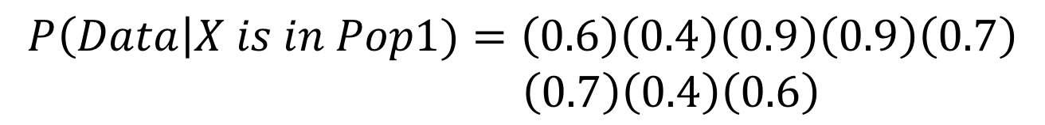
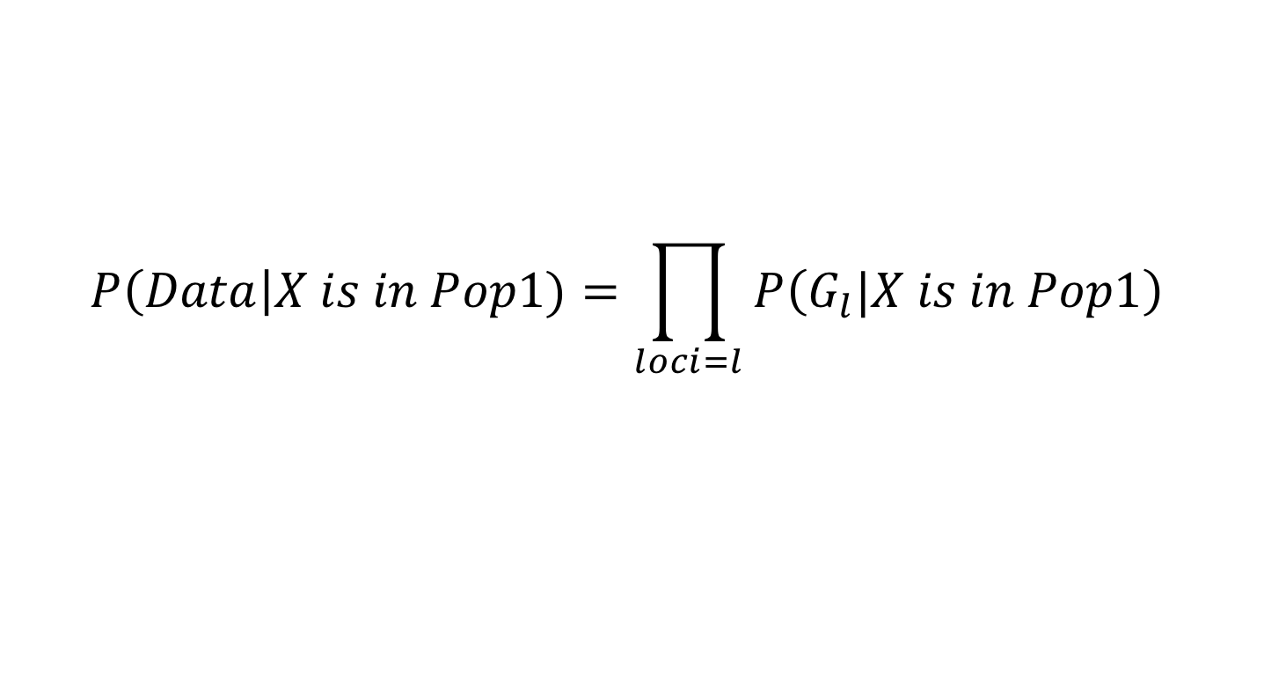
 | SNP 1 | SNP 2 | SNP 3 | SNP 4
 | A/T | G/C | T/C | T/G | …
Pop1 | 0.6/0.4 | 0.9/0.1 | 0.7/0.3 | 0.4/0.6 | …
Pop2 | 0.5/0.5 | 0.3/0.7 | 0.8/0.2 | 0.1/0.9 | …
Ind X
Ind X | A/T | G/G | T/T | T/G | …
$$P\left(Data\right|X is in Pop1)=\left(0.6\right)\left(0.4\right)\left(0.9\right)\left(0.9\right)\left(0.7\right)$$
$\left(0.7\right)\left(0.4\right)\left(0.6\right)$
$$P\left(Data\right|X is in Pop1)=\prod_{loci=l}{P\left(G_{l}|X is in Pop1\right)}$$

Slide 14
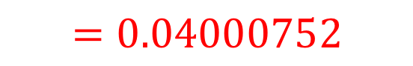
 | SNP 1 | SNP 2 | SNP 3 | SNP 4
 | A/T | G/C | T/C | T/G | …
Pop1 | 0.6/0.4 | 0.9/0.1 | 0.7/0.3 | 0.4/0.6 | …
Pop2 | 0.5/0.5 | 0.3/0.7 | 0.8/0.2 | 0.1/0.9 | …
Ind X
Ind X | A/T | G/G | T/T | T/G | …
$$P\left(Data\right|X is in Pop1)=\left(0.6\right)\left(0.4\right)\left(0.9\right)\left(0.9\right)\left(0.7\right)$$
$\left(0.7\right)\left(0.4\right)\left(0.6\right)$
$$P\left(Data\right|X is in Pop1)=\prod_{loci=l}{P\left(G_{l}|X is in Pop1\right)}$$
$$=0.04000752$$

Slide 15
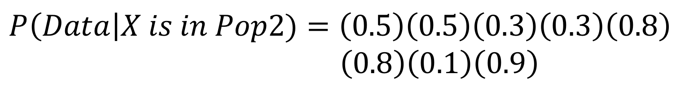
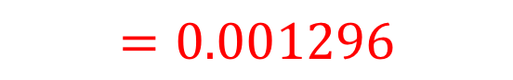
 | SNP 1 | SNP 2 | SNP 3 | SNP 4
 | A/T | G/C | T/C | T/G | …
Pop1 | 0.6/0.4 | 0.9/0.1 | 0.7/0.3 | 0.4/0.6 | …
Pop2 | 0.5/0.5 | 0.3/0.7 | 0.8/0.2 | 0.1/0.9 | …
Ind X
Ind X | A/T | G/G | T/T | T/G | …
What about Pop 2?
$$=0.001296$$

Slide 16
 | SNP 1 | SNP 2 | SNP 3 | SNP 4
 | A/T | G/C | T/C | T/G | …
Pop1 | 0.6/0.4 | 0.9/0.1 | 0.7/0.3 | 0.4/0.6 | …
Pop2 | 0.5/0.5 | 0.3/0.7 | 0.8/0.2 | 0.1/0.9 | …
Ind X
Ind X | A/T | G/G | T/T | T/G | …
$$P\left(Data\right|X is in Pop1)=0.04000752$$
$$P\left(Data\right|X is in Pop2)=0.001296$$
ML assignment to Pop 1…

Slide 17
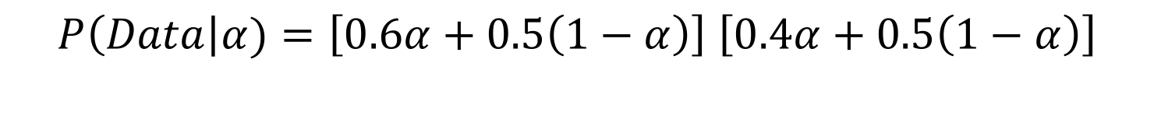
 | SNP 1 | SNP 2 | SNP 3 | SNP 4
 | A/T | G/C | T/C | T/G | …
Pop1 | 0.6/0.4 | 0.9/0.1 | 0.7/0.3 | 0.4/0.6 | …
Pop2 | 0.5/0.5 | 0.3/0.7 | 0.8/0.2 | 0.1/0.9 | …
Ind X
Ind X | A/T | G/G | T/T | T/G | …
Extending to the case of admixture…
If an individual has 𝛼 ancestry from Pop 1 and 1- 𝛼 ancestry from Pop 2:
A from Pop1 OR Pop2
T from Pop1 OR Pop2
$P\left(Data\right|α)=\left[0.6α+0.5\left(1−α\right)\right]$ $\left[0.4α+0.5\left(1−α\right)\right]$

Slide 18
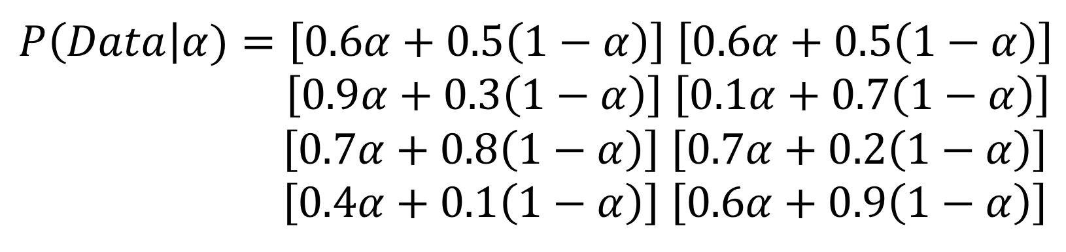
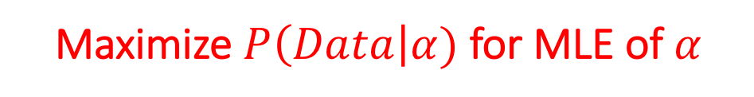
 | SNP 1 | SNP 2 | SNP 3 | SNP 4
 | A/T | G/C | T/C | T/G | …
Pop1 | 0.6/0.4 | 0.9/0.1 | 0.7/0.3 | 0.4/0.6 | …
Pop2 | 0.5/0.5 | 0.3/0.7 | 0.8/0.2 | 0.1/0.9 | …
Ind X
Ind X | A/T | G/G | T/T | T/G | …
Maximize $P\left(Data\right|α)$ for MLE of 𝛼

Slide 19
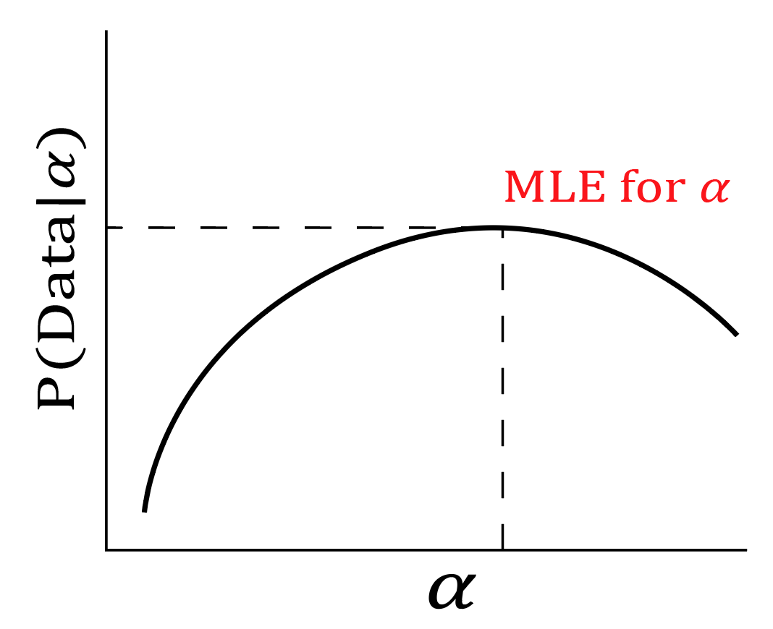

Slide 20
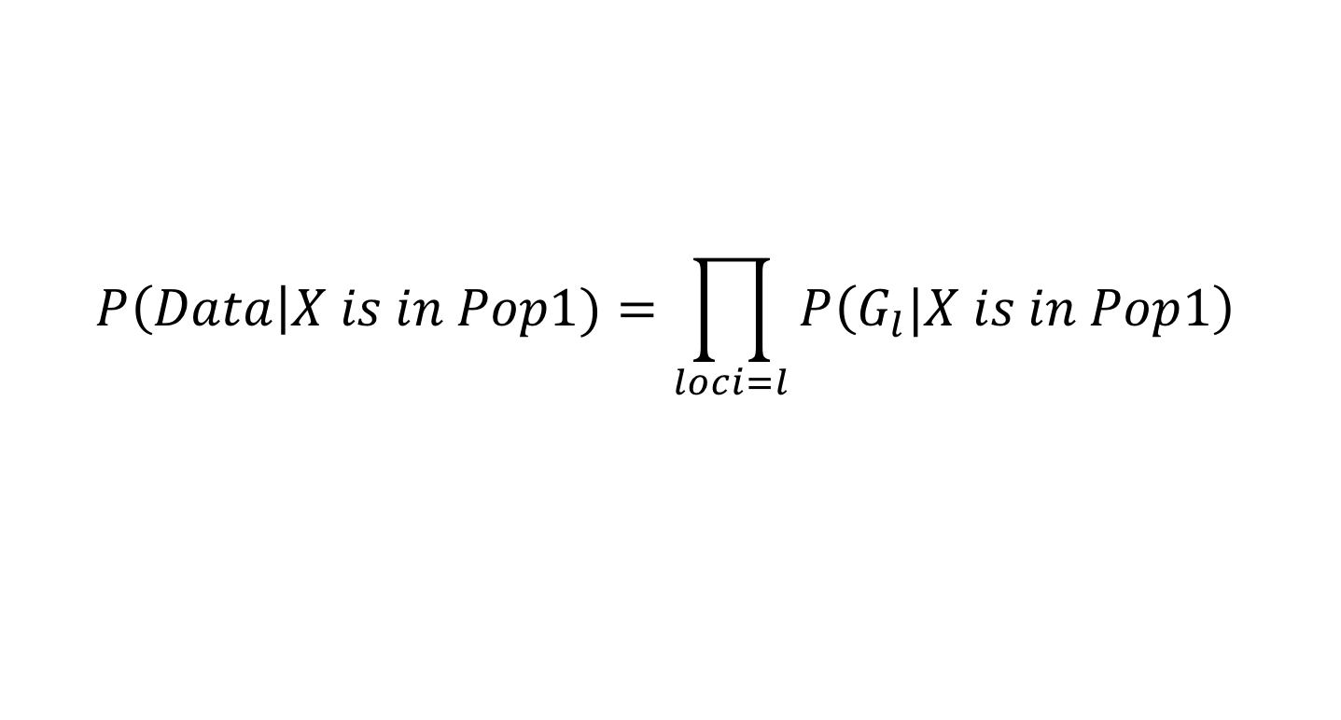
What’s the point??
1. We make several assumptions when calculating likelihoods of assignment
$$P\left(Data\right|X is in Pop1)=\prod_{loci=l}{P\left(G_{l}|X is in Pop1\right)}$$

Slide 21
What’s the point??
1. We make several assumptions when calculating likelihoods of assignment
$$P\left(Data\right|X is in Pop1)=\prod_{loci=l}{P\left(G_{l}|X is in Pop1\right)}$$
Assumes no LD
Assumes no assortative mating (HWE)

Slide 22
What’s the point??
2. We make can easily assign individuals to populations, when allele frequencies are known (even accounting for admixture)…
$$P\left(Data\right|X is in Pop1)=\prod_{loci=l}{P\left(G_{l}|X is in Pop1\right)}$$

Slide 23
What’s the point??
3. …OR we can easily calculate allele frequencies of populations when individual assignments are known.
 | SNP 1 | SNP 2 | SNP 3 | SNP 4
 | A/T | G/C | T/C | T/G | …
Pop1 | 0.6/0.4 | 0.9/0.1 | 0.7/0.3 | 0.4/0.6 | …
Pop2 | 0.5/0.5 | 0.3/0.7 | 0.8/0.2 | 0.1/0.9 | …

Slide 24
What’s the point??
What about when we don’t know populations a priori??

Slide 25
What’s the point??
What about when we don’t know populations a priori??
Structure (Pritchard et al 2000) uses Bayes Theorem and MCMC to come up with joint estimates of both

Slide 26
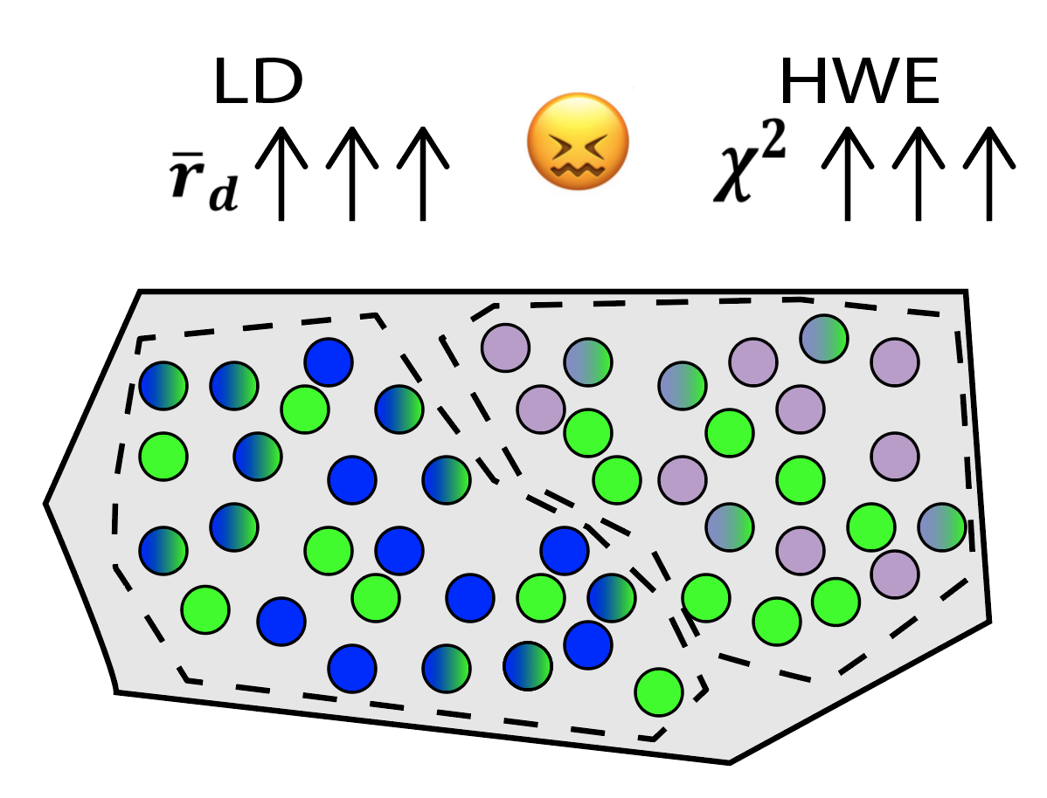

Slide 27
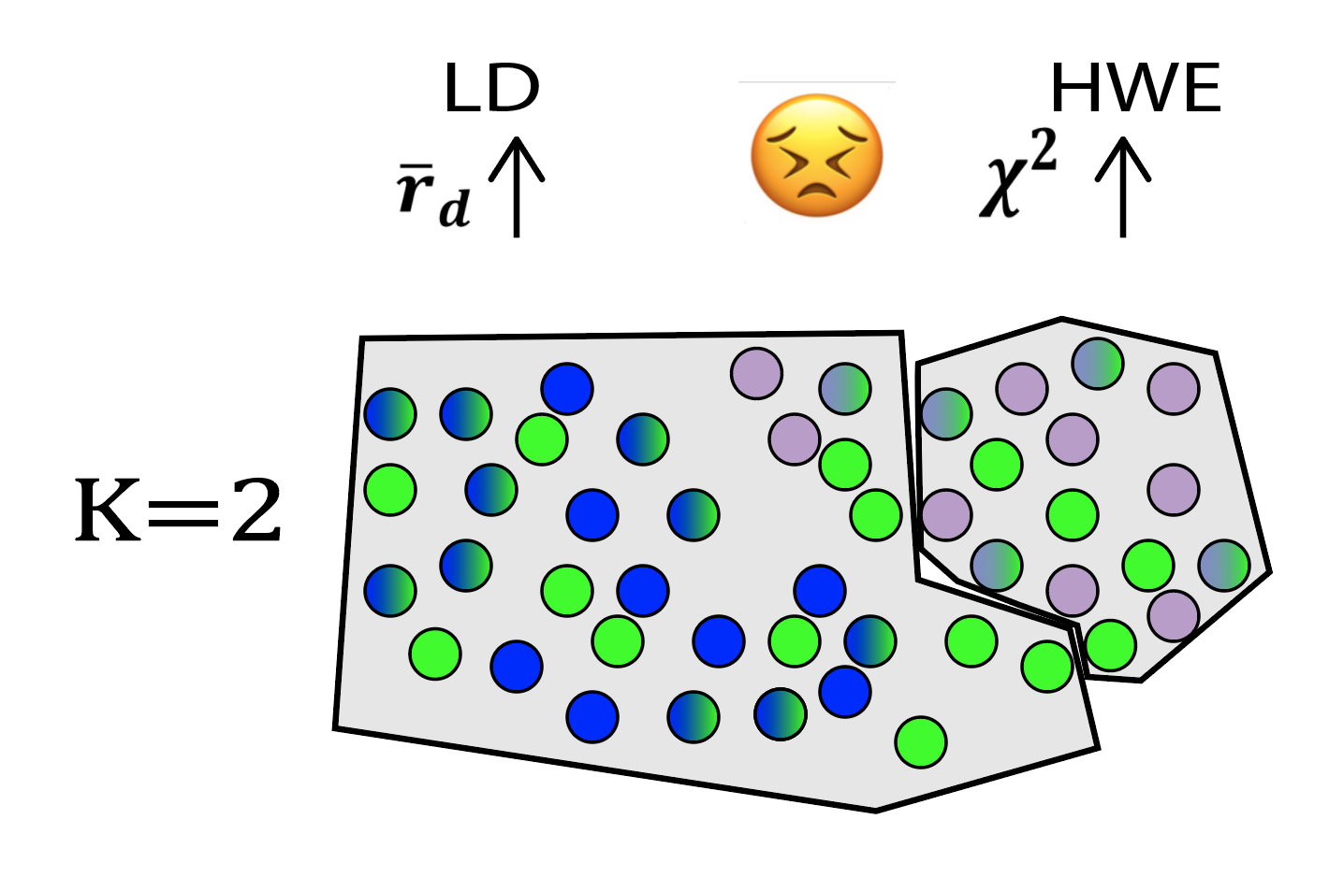

Slide 28
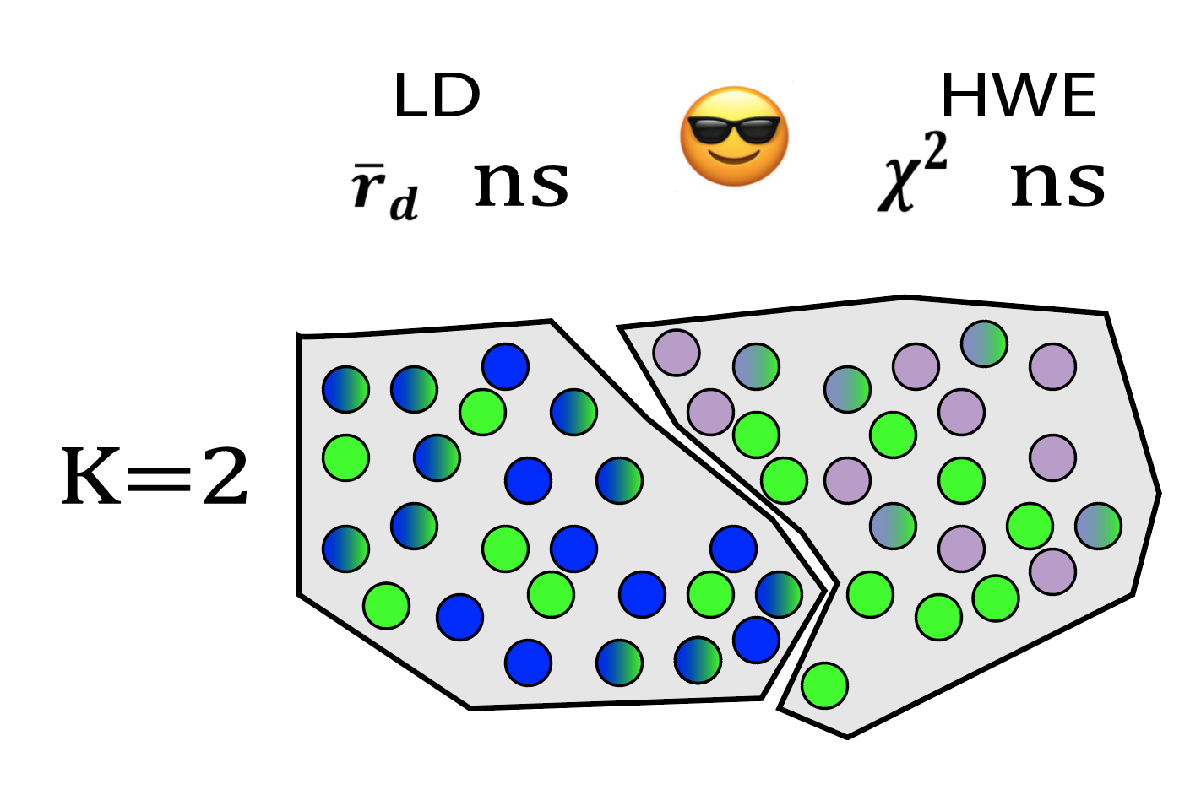

Slide 29
STRUCTURE (Pritchard et al 2000)
Process:
Randomly assign individuals to K number of populations (user defined K)
Calculate allele frequencies for the K populations
Assign individuals to populations
MCMC
Re-assign individuals to minimize LD and HWE departure
Re-estimate assignments
Repeat for X number of iterations

Slide 30
STRUCTURE (Pritchard et al 2000)
Sample groups are blocks

Slide 31
STRUCTURE (Pritchard et al 2000)
Individuals are bars
Sample groups are blocks

Slide 32
STRUCTURE (Pritchard et al 2000)
Individuals are bars
Sample groups are blocks
Colors are inferred gene pool (here K=6)

Slide 33
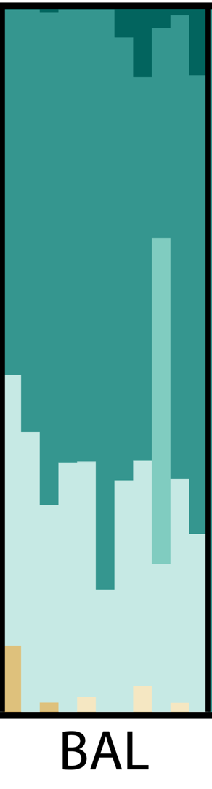
STRUCTURE (Pritchard et al 2000)
Colors represent posterior probabilities of assignment to clusters

Slide 34
STRUCTURE (Pritchard et al 2000)
Mixed assignment can result from:
Admixture
Weakly differentiated populations
Artefacts of unrealistic K values
Input from unsampled population
God

Slide 35
STRUCTURE (Pritchard et al 2000)
Critical assumptions
The chosen value of K represents real clusters in the data
The software will create any number of populations you specify, whether these represent true groups or not…
…The general scheme is to run Structure for a range of K values (e.g. 1-10), and select optimal K after

Slide 36
STRUCTURE (Pritchard et al 2000)
Critical assumptions
The chosen value of K represents real clusters in the data
Those clusters can be delimited by assuming real biological populations are in HWE and lack LD
You should be reasonably sure your loci aren’t linked (hence testing for LD)
AND be aware that anything which causes departure from HWE (e.g. bottlenecks) can affect your results

Slide 37
STRUCTURE (Pritchard et al 2000)
Critical assumptions
The chosen value of K represents real clusters in the data
Those clusters can be delimited by assuming real biological populations are in HWE and lack LD
All individuals are a composite of ancestral populations, and all of those populations are sampled
Gene flow from un-sampled populations will affect your results.

Slide 38
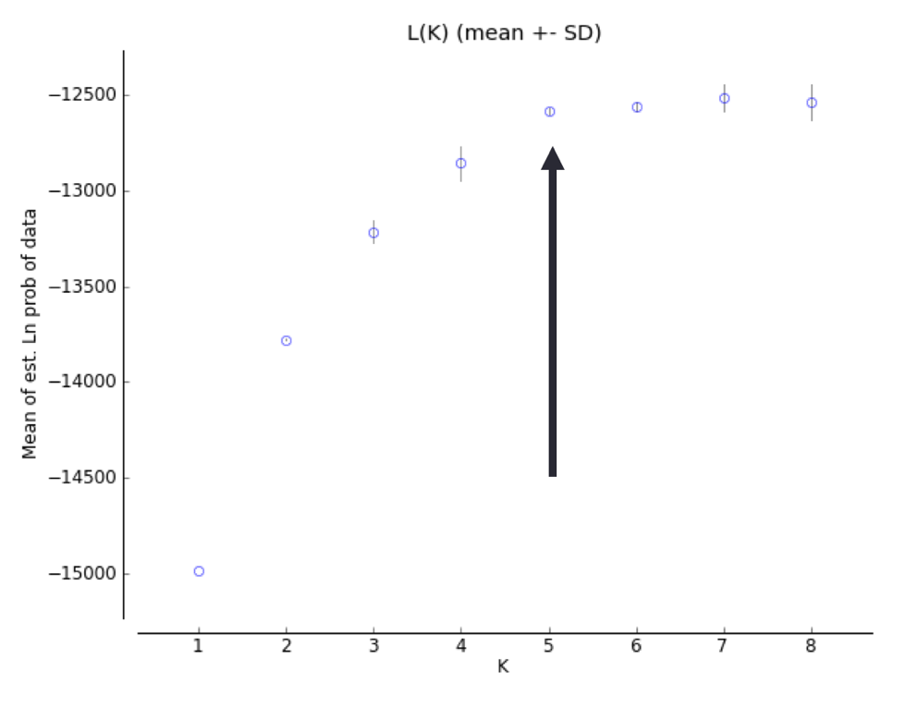
How to run Structure properly.
Problem: Value of K may not represent reality
Solution: Run multiple K values, and choose optimal K
Structure does not do this for you. Multiple methods:
Plot ln(L)
Often increases infinitely with K, look for plateau

Slide 39
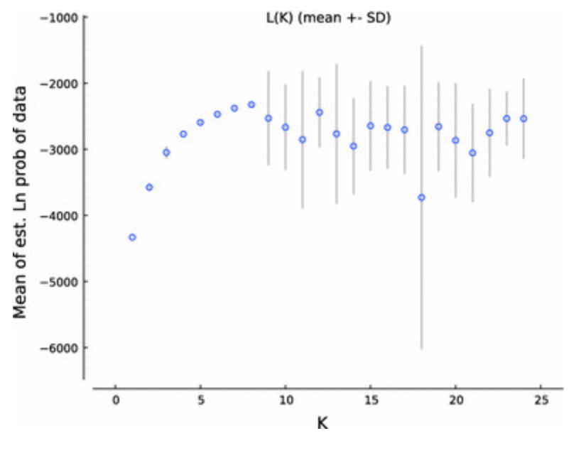
How to run Structure properly.
Problem: Value of K may not represent reality
Solution: Run multiple K values, and choose optimal K
Structure does not do this for you. Multiple methods:
Plot ln(L)
Variability among replicates generally gets very high once K exceeds anything reasonable

Slide 40
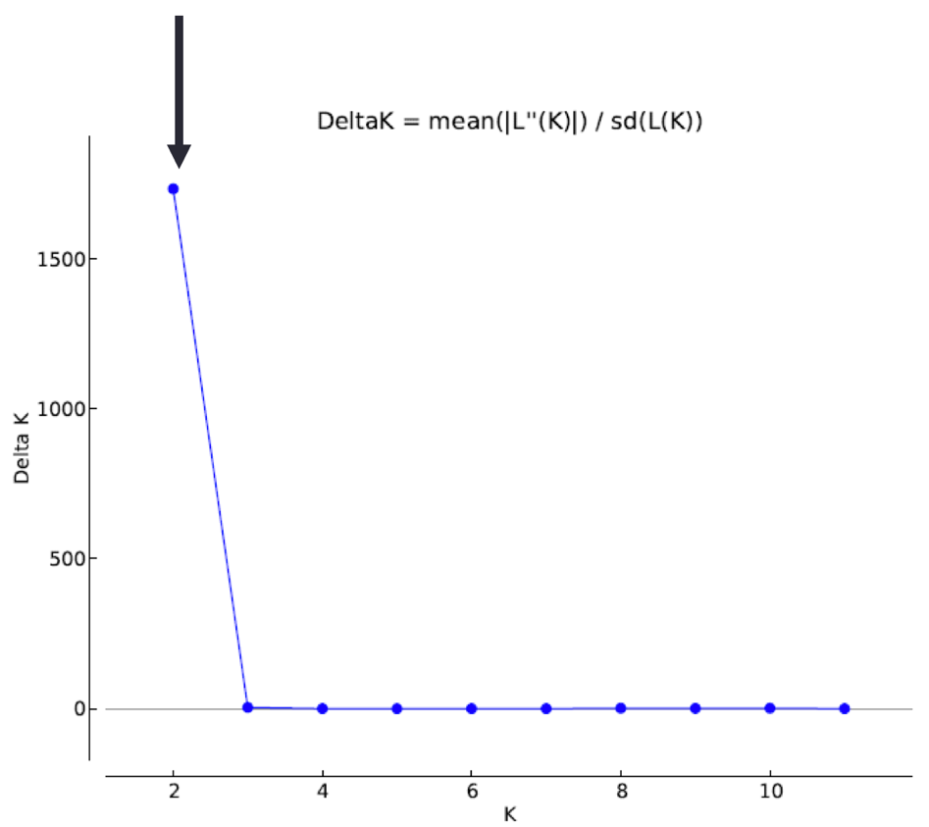
How to run Structure properly.
Problem: Value of K may not represent reality
Solution: Run multiple K values, and choose optimal K
Structure does not do this for you. Multiple methods:
Plot ln(L)
Evanno method
Needs replicates to calculate sd(L(K)), so you might have to run much longer.

Slide 41
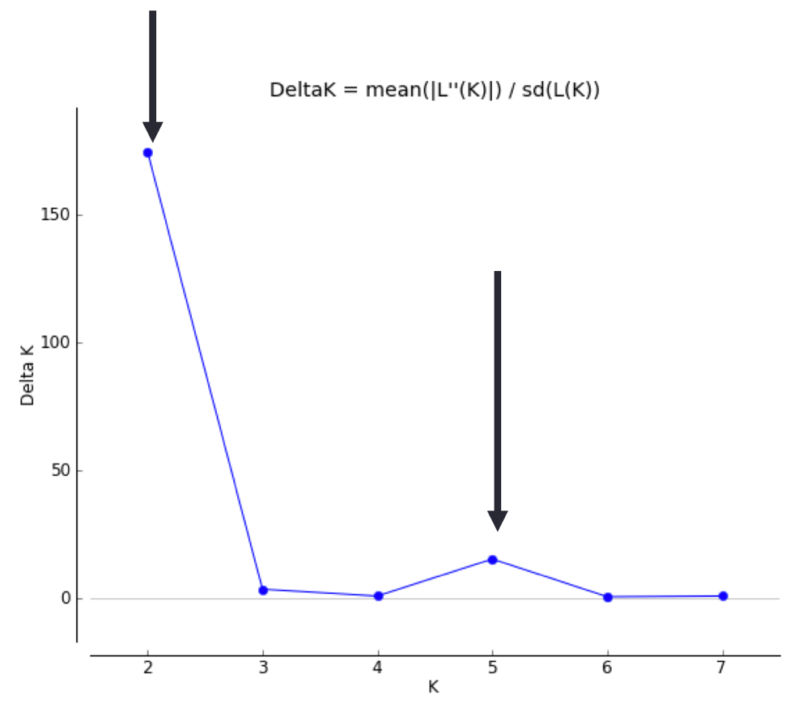
How to run Structure properly.
Problem: Value of K may not represent reality
Solution: Run multiple K values, and choose optimal K
Structure does not do this for you. Multiple methods:
Plot ln(L)
Evanno method
Can help see potential hierarchical structure

Slide 42
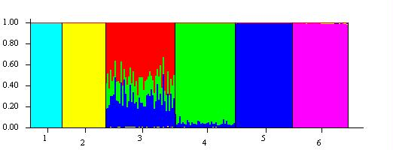
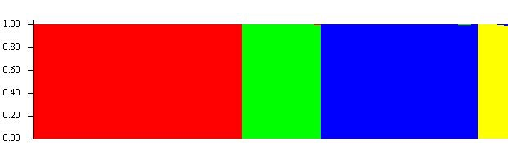
How to run Structure properly.
Problem: Model may not represent reality
Most important model selections you will make:
Ancestry model: Admixture or no admixture?
Only select “no admixture” if you are VERY sure populations represent non-breeding groups.

Slide 43
How to run Structure properly.
Problem: Model may not represent reality
Most important model selections you will make:
Ancestry model: Admixture or no admixture?
Allele frequency model: Correlated/ Uncorrelated?
Similarly, we can constrain allele frequencies among populations to be independent of one another (uncorrelated), or correlated (e.g. due to gene flow).
Use your biological knowledge. There is no equivalent to JModelTest for Structure.

Slide 44
How to run Structure properly.
Problem: Model may not represent reality
Most important model selections you will make:
Ancestry model: Admixture or no admixture?
Allele frequency model: Correlated/ Uncorrelated?
Population Priors: LOCPRIOR or no LOCPRIOR
Structure can use a priori assignments (e.g. by location, or according to your pre-conceived notions) to inform population delimitation…
Warning: With weak data, the priors will over-ride the signal.

Slide 45
How to run Structure properly.
Problem: Model may not represent reality
Most important model selections you will make:
Ancestry model: Admixture or no admixture?
Allele frequency model: Correlated/ Uncorrelated?
Population Priors: LOCPRIOR or no LOCPRIOR
MCMC length and sampling
With all MCMC methods, you must assess for mixing and autocorrelation afterwards. Unfortunately, Structure (via the command-line) does not report complete trace files

Slide 46
How to NOT to run Structure properly
Oversample your focal population so it drives patterns of allele frequency
Choose value of K which gives results closest to you’re a priori expectations
Favorite population not distinct? No problem! Just increase K until it is!
Fabricate signal in weak data using informative priors!
Lawson et al (2018) bioRxiv: A tutorial on how (not) to over-interpret STRUCTURE/ADMIXTURE bar plots

